Slide 1
MINI PROJECT COVID-19 DATA ANALYSIS
Submitted by:-
Nimisha Pachauri
Parakh Tiwari
B.Tech CS IIIrd Year
Univ.Roll.no.:- 181500430
181500450

Slide 2
About The Project…
The project aims at deeply analysing the contain and spread of the world pandemic Corona virus, also known as Covid-19 in Indian subcontinent and other parts of the world, which has made a foot fall in December 2019 from the city of Wuhan, China. The project uses various technologies for analysing the spread of the virus through charts, graphs, tables, maps and various representations methods.
Today, as we all know how much the virus is spreading and making its roots across the country and the world, the data that we will represent in this project, will give us a thorough study of the numbers upto which the virus is spreading among the locals, how steeply the number of patients are rising, the number of recoveries, active patients and the number of deceased.
The project also gives a time series analysis of the pandemic which helps us to predict the future projection of the disease, which will help us to plan the future actions that should be taken for controlling and stopping its contain. This could help us to understand the extent of corona virus spread in the country and the world and, in turn, it could help us to study what effects the measures have done, taken in the past, and now what shall be done in future to control the spread.
The project will reduce the searching and analysing of covid19 data for the users and analysts who has to search at different places for such data, maintain the record of the data and has to generate reports of the contain and spread of the data. The project will also help the government, doctors, police, media, journalists and other concerned authorities who require the data for analysing purpose and report making and to place the future actions that should be taken for controlling the same, knowing the past mistakes.

Slide 3
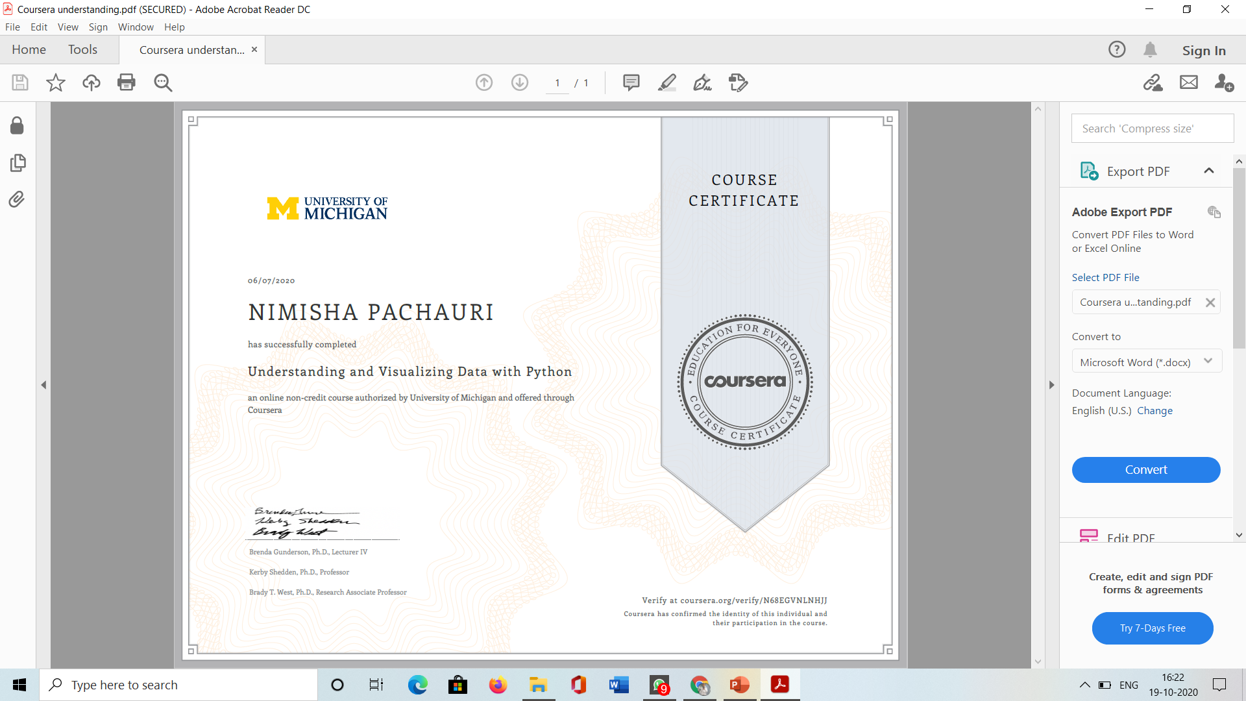

Slide 4
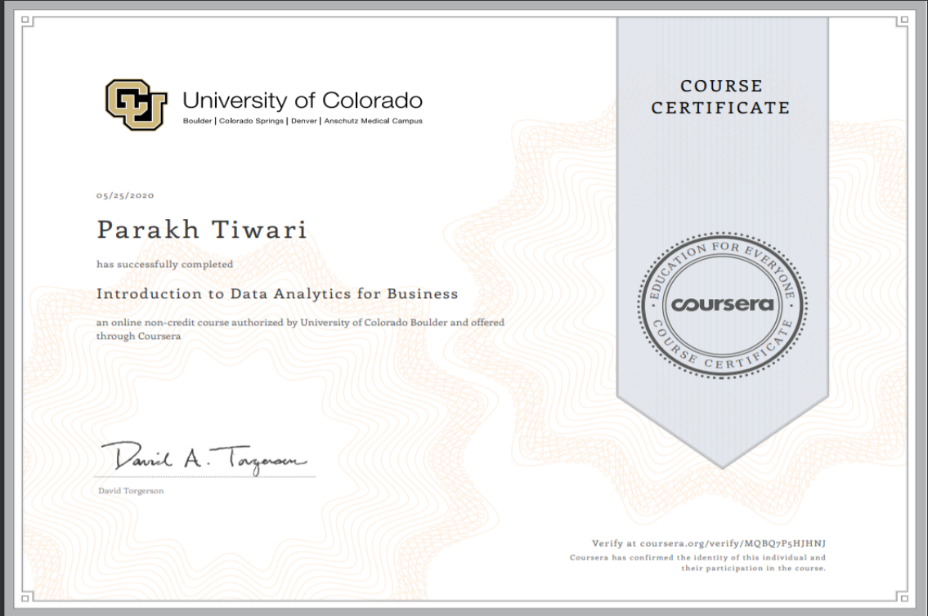

Slide 5
Objective Of The Project
The project on COVID-19 DATA ANALYSIS with PYTHON, is introduced to the field of statistics, including where data come from, study design, data management, and exploring and visualizing data. From this course one is able to identify different types of data, and learn how to visualize, analyse, and interpret summaries for both univariate and multivariate data.
During the project work we were able to discover the different uses of Python as a tool,
including the Numpy, Pandas, Matplotlib, and Seaborn libraries. Tutorial videos were provided in the courses that made us go through the creation of visualizations and data management, all within Python. This project utilizes the Jupyter Notebook.

Slide 6
About The Project…
The project aims at deeply analysing the contain and spread of the world pandemic Corona virus, also known as Covid19 in Indian subcontinent and other parts of the world, which has made a foot fall in December 2019 from the city of Wuhan, China. The project uses various technologies for analysing the spread of the virus through charts, graphs, tables, maps and various representations methods.
Today, as we all know how much the virus is spreading and making its roots across the country and the world, the data that we will represent in this project, will give us a thorough study of the numbers upto which the virus is spreading among the locals, how steeply the number of patients are rising, the number of recoveries, active patients and the number of deceased. It also gives a thorough study of the data of specified places where the cases are more, places where the cases are less, states which are able to control the disease, the population effected, groups of ages of the people who are effected, who among males and females are effected, who are at higher risk of infection, who has lower risk of infection and many other deep studies related to the pandemic.
The project also gives a time series analysis of the pandemic which helps us to predict the future projection of the disease, which will help us to plan the future actions that should be taken for controlling and stopping its contain. This could help us to understand the extent of corona virus spread in the country and the world and, in turn, it could help us to study what effects the measures have done, taken in the past, and now what shall be done in future to control the spread.
The project will reduce the searching and analysing of covid19 data for the users and analysts who has to search at different places for such data, maintain the record of the data and has to generate reports of the contain and spread of the data. The project will also help the government, doctors, police, media, journalists and other concerned authorities who require the data for analysing purpose and report making and to place the future actions that should be taken for controlling the same, knowing the past mistakes.

Slide 7
Skills Gained
Data Anslysis
Data Quality
Data Model
Different Types of Data
Various Python Libraries like pandas

Slide 8
What I learned From The Project
Analytical Tools
In this module, I have learned about the technologies that enable analytical work. I have examined data storage and databases, including the relational database. About Big Data and Cloud technologies and ideas like federation, virtualization, and in-memory computing and also walk through a landscape of some of the more common tool classes and learned how these tools support common analytical tasks.

Slide 9
THE PROJECT WORK

Slide 10
About The Problem
The problem was about a large data set given to us in which the data was completely unorganised and no information could be traced from the data set. In order to fetch useful information from the data like particular weather on a particular day, days which were cold or hot, wind speed, average of temperature or any related information, I have created this project so that the data could become readable, useful information can be extracted from it and the data can be used purposely by any organisation or person in an efficient way.

Slide 11
Tools Used for Solving the Problem
Jupyter Notebook
Python Pandas
MS Excel

Slide 12
Jupyter Notebook
JupyterLab is a web-based interactive development environment for Jupyter notebooks, code, and data. JupyterLab is flexible: configure and arrange the user interface to support a wide range of workflows in data science, scientific computing, and machine learning. JupyterLab is extensible and modular: write plugins that add new components and integrate with existing ones.
All the codes were writtern on this platform, compiled and runned. This platform supports all the libraries of python example, pandas, matplotlib, folium, plotly, etc.

Slide 13
Python Pandas
Pandas is an open-source Python Library providing high-performance data manipulation and analysis tool using its powerful data structures. The name Pandas is derived from the word Panel Data – an Econometrics from Multidimensional data.
In 2008, developer Wes McKinney started developing pandas when in need of high performance, flexible tool for analysis of data.
Prior to Pandas, Python was majorly used for data munging and preparation. It had very little contribution towards data analysis. Pandas solved this problem. Using Pandas, we can accomplish five typical steps in the processing and analysis of data, regardless of the origin of data — load, prepare, manipulate, model, and analyse.
Python with Pandas is used in a wide range of fields including academic and commercial domains including finance, economics, Statistics, analytics, etc.
It provides highly optimized performance with back-end source code is purely written in python.

Slide 14
MS Excel
Excel is an electronic spreadsheet program that is used for storing, organizing, and manipulating data.
In this project, it is used to make the database of daily basis Weather reports in a serial manner, easy to distinguish. The data is stored in spread sheet in a CSV format, which was later imported in the Jupyter Notebook to analyse it properly.

Slide 15
The Working Project

Slide 16
Overall Experience
The work responsibilty that we took for completing this project is of a Data Analyst. During our project completion, we have learned about how it feel to bs an analyst, how an analyst is needed for answering various questions from a given dataset and how conclusions are drawn. The work can that we have done for this training could be done better if we would have gone deeper into the studies.
We have implemented lot of more things like maps, progressions, bar graphs and other such representations if we had more time to go further into the studies and become a reliable data analyst for an organisation. We must say that we had already stepped into the world of a data analyst and have started experiencing the long to go journey but we could have gained more experience into this if we had a personal guide with me who has an experience into this field, so that we would have done better and submitted a better report of our training and project work. we learned a lot from this training and project which would help us to go for further studies into this with an experience of a beginner so that we could do a specialization in this field and do much better than what we have done in this project and could learn more in this field and become a specialist in the field of data analysis.

Slide 17
THANK YOU

